Slide 1
NIFA Update & Budget Process ESS Business Meeting September 27, 2017 Jeanette Thurston

Slide 2
NIFA Update: People
USDA Leadership
Dr. Sonny Ramaswamy’s appointment ends in May
Dr. Ann Bartuska retired this month
Nominations
Stephen Censky for Agriculture Deputy Secretary
Ted McKinney for Agriculture Undersecretary for Trade and Foreign Agricultural Affairs
Acting Undersecretary for Research, Education, and Economics—Dr. Chavonda Jacobs-Young, ARS Administrator
Many new Faces at NIFA— Director Equal Opportunity, NPLs, Program Specialists, Institute & OGFM Division Directors, AAAS fellows

Slide 3
Addressing EOs and other Activities
Interagency Task Force on Ag and Rural Prosperity
NSTC Subcommittee on Food and Agriculture
2018 Agriculture Outlook Forum
THANK YOU!
February 22-23, 2018
Breakthroughs 2030
NIFA Leadership Meetings with Secretary and Senior Advisors
Relevancy, quality, and performance

Slide 4
New Programs, AFRI & Other Important Information
New Program: Enhancing Agricultural Opportunities for Military Veterans (2017 Omnibus Spending Bill)
2018 AFRI Program
Foundational and Applied Science (~$221M)
Sustainable Agriculture Systems (~$66M)
Education and Workforce Development (~$24M)
Calls to Conversation
1994 LGUs
Tactical Science
Positive Youth Development
Expanded Food and Nutrition Program
Food & Ag Cyberinformatics & Tools (FACT) Initiative

Slide 5
NIFA State Liaison Program, Strategic Plan, and Celebrating CAPs
NIFA State Liaison Program
Rollout October
NIFA Strategic Plan 2019-2023
Input from partners ~July/August 2018
AFRI Coordinated Agriculture Projects (CAPs) Symposium—Summer 2018

Slide 6
NIFA Listens—Stakeholder Listening Sessions
Kansas City, Missouri--October 19, 2017
Atlanta, Georgia—October 26, 2017
Sacramento, California—November 2, 2017
Hyattsville, Maryland—November 8, 2017
Stakeholder Input Form on website
NIFAlistens@nifa.usda.gov
Comment period closes Dec. 1, 2017
https://nifa.usda.gov/nifalistens

Slide 7
Budget
FY18
“minibus” $1.51B
FY19
Departmental Pass back…let’s talk about our process…

Slide 8
Activities that Inform NIFA’s Annual Budget
SCIENCE EMPHASIS AREAS
STRATEGIC PLAN
STAKEHOLDER
INPUT
INTERNAL
(Formal process in
February/March)
EXTERNAL
(All year; Formal Listening Sessions in October/November)
AGENCY BUDGET
PRIORITIES
Department & Administration
PRESIDENT’S BUDGET
(February)
Congress
APPROPRIATIONS ACT

Slide 9
Timeline for NIFA’s Annual Budget Process
2. NIFA’s Science Week
(February/March)
3. NIFA Budget Planning Process
(March-May)
1. External Stakeholder Input
(Formal: October/November)
Best time for input-Before April
4. Submit NIFA proposed Budget to USDA Secretary through the Undersecretary for REE
(June)
5. Departmental Passback
(July/August)
6. OMB Passback
(December)
Begin next FY Budget Process!
9. NIFA Attends Appropriations Hearings, Responds to Congressional Requests
(March-May)
7. Final Presidents’ Budget submitted to USDA via OMB
(January)
10. FYXXXX
Appropriations Act
8. President’s Budget Released
(February)

Slide 10
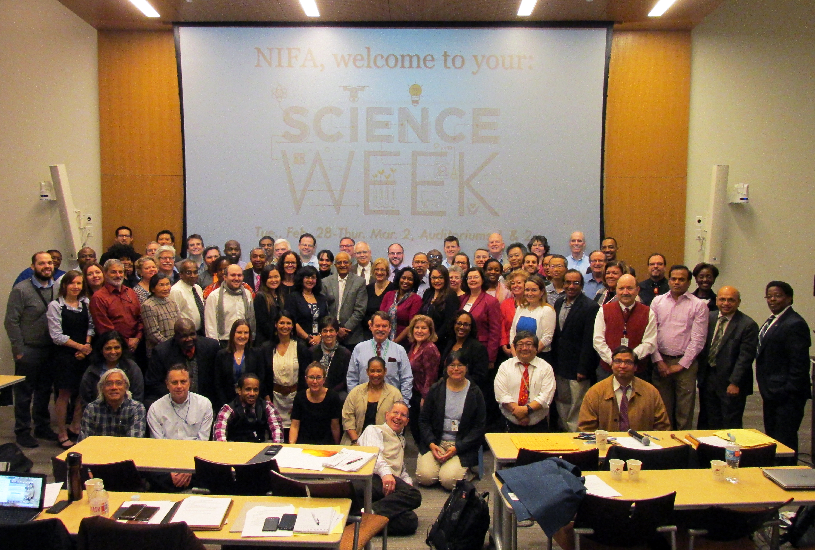
Questions?

