Slide 1
Moving from Diversity to Inclusion: A Developmental Process
Presented by
Pamala V. Morris, PhD.
College of Agriculture, Purdue University and
Patreese Ingram, PhD.
College of Agricultural Sciences, The Pennsylvania State University
ESS/SAES/ARD Fall Meeting
September 27, 2017

Slide 2
Ground Rules for Discussion
Try on
It’s OK to disagree
It’s NOT OK to blame, shame or attack
Practice self-focus
Notice both “content/what is said and process/presented & experienced”
Practice “both/and” thinking
Be aware of “intent and impact” (words may have unintended consequences)
Maintain confidentiality

Slide 3
Diversity is:
Diversity refers to all of the ways in which people are different. This includes individual, group, and cultural differences.
…

Slide 4
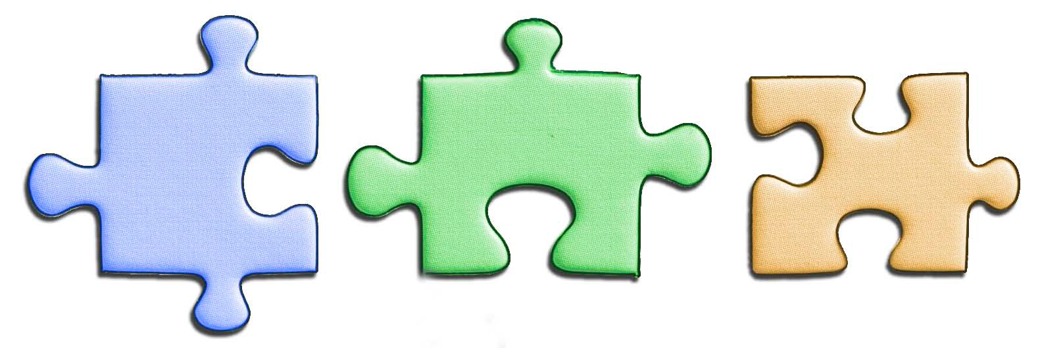
Diversity is….
a mosaic of people who bring a variety of backgrounds, styles, perspectives, values, and beliefs as assets to the group and organizations with which they connect

Slide 5
Diversity
Diversity has always been a powerful, even a necessary, catalyst for intellectual progress
        ----David H. Porter, President Emeritus, Skidmore College

Slide 6
Why is Diversity Important
Major business advantage in diversifying the workplace:
  Attract/retain best human talent
  Achieve higher creativity/innovation
  Gain and keep minority market share

Slide 7

INCLUSION
The active, intentional, and ongoing engagement with diversity—in people, in cultural programs, in continued dialog designed to increase/create---
awareness/sensitivity/respect
People feel welcome/valued contributors
Open communication
  Effective and appropriate
  clear channels for feedback
  active listening and responding
  Increased awareness of nonverbal cues (e.g., facial expressions, body language)

Slide 8
Moving from Diversity to Inclusion
Diversity + Intercultural Competence = Inclusion

Slide 9
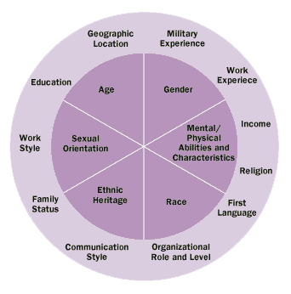
Dimensions of Diversity

Slide 10
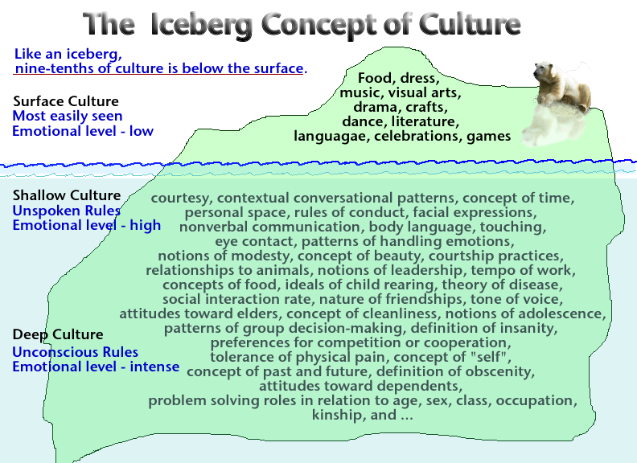

Dimensions of Diversity
May be hidden or visible (iceberg)
                Are found within groups/individuals

Slide 11
Key Concepts
Diversity
Is the mix of differences
Inclusion
Is “making the mix work”
Intercultural Competence
Is “how to achieve Diversity & Inclusion goals
Copyright, 2007, 2009 Mitchell R. Hammer, Ph.D.

Slide 12
Intercultural Competence is Imperative
Increasing our “Intercultural Competence” is a core capability in the 21st century and involves:
  Opening our minds to different people, cultures, and opportunities!
  Ability to recognize, understand, and adapt to differences
  Enhanced cultural self-awareness
  Developing empathy – being able to understand someone else’s thoughts and emotions!

Slide 13
Intercultural Transformation
We can help others---and ourselves---transform through engaging in a four step process:
  Increasing awareness of our own characteristic ways of making meaning in familiar and unfamiliar cultural environments;
  Increasing awareness of others’ ways of making meaning in familiar and unfamiliar cultural environments;
  Managing our emotions and thoughts (EI) in the face of ambiguity, change and challenging circumstances;
  Bridging cultural gaps between ourselves and others ---shift our perspectives, attuning our emotions and adapting our behavior in effective and appropriate ways.

Slide 14
Changing Cultural Landscape
The real voyage of discovery consist not in seeking new landscapes but in having new eyes
                -----Marcel Proust

Slide 15
Diversity Facts
By 2060 ethnic minorities are expected to be at least what proportion of U.S. population:
  50%
Women/minorities are what proportion of new employees entering workplace?
  47% (of this % - 33% are women of color)
Proportion of women/minorities who are managers in the top 100 Fortune 500 companies:
  Approx. 9% (Glass Ceiling)

Slide 16
Stepping Outside of Ourselves
Double consciousness - awareness of own perspective and perspective of others
  (Perspective shifting) An essential life skill!!!

Slide 17
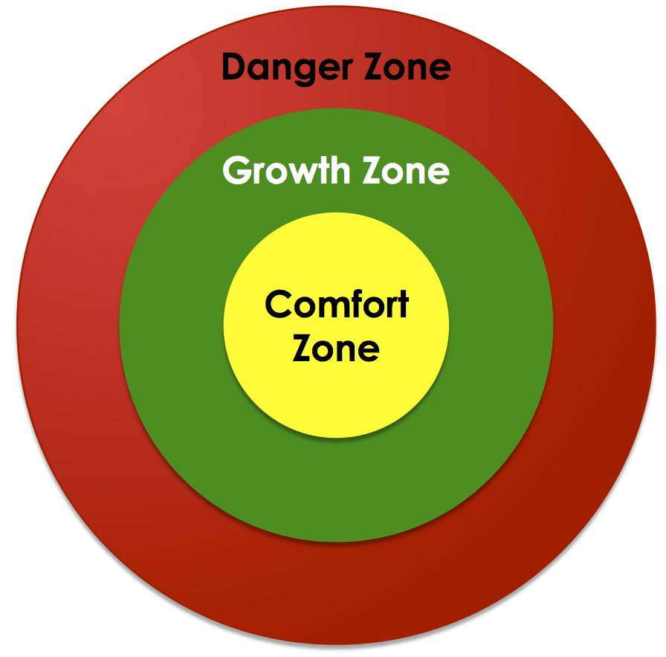
Learning Zone

Slide 18
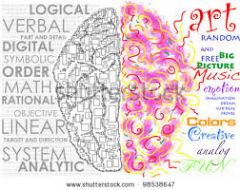
Perspective Shifting
It’s about thinking differently.
Thinking differently helps us to understand and appreciate the perspective of others.
Flexibility in perspective becomes Cultural Competence and Cultural Elasticity

Slide 19
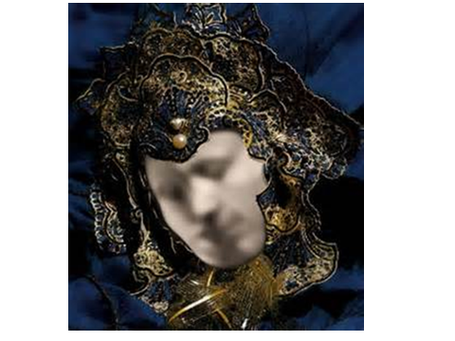

Slide 20

“What do you see?”
Notes:
learner

Slide 21
The Danger of a Single Perspective
https://www.youtube.com/watch?v=VrSUe_m19FY

Slide 22

Intercultural Development Continuum: Primary Orientations
Denial
Polarization
Minimization
Acceptance
Adaptation
Bridges across Difference
Deeply Comprehends Difference
Intercultural
Mindset
De-emphasizes Difference
Judges Difference
Misses Difference
Monocultural
Mindset
Modified from the Developmental Model of Intercultural Sensitivity (DMIS), M. Bennett, 1986
Notes:
Review each primary orientation.

Slide 23
IDI Group Profile Feedback- Total ESS Group
Perceived Orientation (PO)
Developmental Orientation (DO)
123.21
123.43
55 70 85 100 115 130 145
100.33
55 70 85 100 115 130 145

Slide 24
IDI Group Profile Feedback-
Total ESS Group

Slide 25
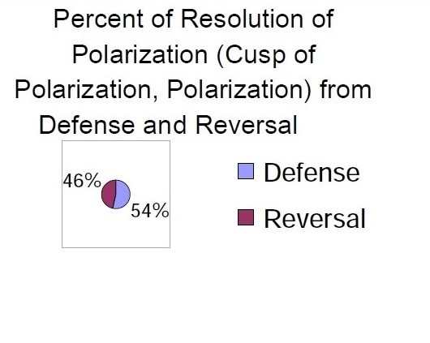
Percent of Resolution

Slide 26
Denial
Recognizes more observable cultural differences (food, music & etc.)
May not notice deeper cultural differences (communication styles)
May avoid or withdraw from cultural differences

Slide 27
Denial of Difference or Diversity
I have never had to think about it
I do not have much contact with …
Live and let live … that is what I say
As long as we all speak the same language
I can be successful in any culture

Slide 28
Denial: Developmental Task
Recognize the existence of cultural differences and diversity

Slide 29
Denial: Appropriate Skills
Ability to gather appropriate information about culture
Initiative to explore aspects of culture
Ability to recognize difference or diversity
Trust, friendliness, cooperation

Slide 30
Polarization
Judgmental orientation that views cultural differences as “us” versus “them”
  Defense: uncritical view of own culture and overly critical of other cultural values and practices
  Reversal: overly critical of own culture, values, and practices and uncritical view of other cultures

Slide 31
Polarization: Defense
I wish these people would just talk the way we do
Other cultures make you realize how much better the USA is
These people do not value life like we do
Boy, could we teach these people a lot of stuff

Slide 32
Polarization: Avoidance
I am embarrassed by people from my country
I wish I could give up my own cultural background and be like one of these people
These people are so sophisticated, not like the superficial people back home

Slide 33
Polarization: Developmental Task
Mitigate polarization by emphasizing our “common humanity”

Slide 34
Polarization: Appropriate Skills
Discipline to maintain personal control
Ability to manage anxiety
Tolerance
Patience

Slide 35
Minimization
Highlights cultural commonality and universal values and principles that may mask deeper recognition and appreciation of cultural differences and diversity

Slide 36
Minimization of Difference or Diversity
This is really not an issue here
All the race that matters is the human race
I am not a racist … I am color blind
Customs differ, but when you get to know them they are pretty much like us
No matter what culture, people are motivated by the same things
Around the world, most values are universal

Slide 37
Minimization: Developmental Task
Develop cultural self-awareness

Slide 38
Minimization: Appropriate Skills
Knowledge of one’s own culture
Open mindedness
Listening skills/Active listening
Culture-general knowledge
Ability to perceive others accurately
Ability to maintain a nonjudgmental interaction posture

Slide 39
Acceptance
Recognizes and appreciate patterns of cultural differences and commonality in one’s own and other cultures

Slide 40
Acceptance of Difference or Diversity
You do not want the same kind of people around
I have a culture and it may give me privilege
I get nervous around diverse people because I do not know how to behave
Difference means more creativity
I study new cultures before I go there
I need to know about relevant cultural differences
Values are different in different cultures. I want to be respectful but maintain my own core values

Slide 41
Acceptance: Developmental Task
Refine analysis of cultural contrasts

Slide 42
Acceptance: Appropriate Skills
Cultural specific knowledge
Cognitive flexibility
Knowledge of other cultures
Contextual knowledge
Respect for other’s values and beliefs
Tolerance of ambiguity

Slide 43
Adaptation
Capable of shifting cultural perspective and changing behavior in culturally appropriate and authentic ways

Slide 44
Adaptation to Difference and Diversity
To solve this dispute, I am going to change my approach
It is fair if I try to meet them half way
I can maintain my values but behave in culturally appropriate ways
I need to change my behavior to account for differences in another culture
I am beginning to feel like a member of another culture

Slide 45
Adaptation Developmental Task
Develop frame of reference shifting skills

Slide 46
Adaptation: Appropriate Skills
Empathy
Risk taking skills
Problem solving skills
Interaction management skills
Flexibility
Social adaptability
Ability to adapt communication patterns

Slide 47
Mindset Summary
Denial: “I’ve never had to think about racism.”
Polarization: “We have a lot to teach these people.”
Minimization: “No matter what their culture, people are pretty much motivated by the same things.”
Acceptance: “Where can I learn more about (x) culture to be more effective in my communication?”
Adaptation: “I can maintain my values and also behave in culturally appropriate ways.”
Jason D. Patent, Ph.D. at Fostering Global Citizens Through Intercultural Leadership Development
2 March 2016 | APAIE Melbourne

Slide 48
Regional ESS IDI Feedback Reports

Slide 49
IDI Group Profile Feedback-
North Central Region
Perceived Orientation (PO)
Developmental Orientation (DO)
125.29
123.43
55 70 85 100 115 130 145
103.23
55 70 85 100 115 130 145

Slide 50
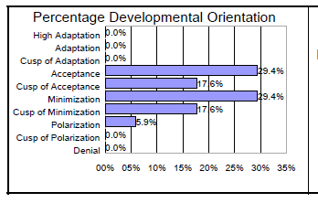
IDI Group Profile Feedback-
North Central Region

Slide 51
IDI Group Profile Feedback-
ARD Region
Perceived Orientation (PO)
Developmental Orientation (DO)
122.75
123.43
55 70 85 100 115 130 145
100.21
55 70 85 100 115 130 145

Slide 52
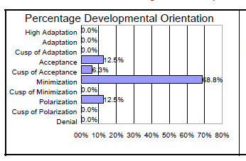
IDI Group Profile Feedback-
ARD Region
Notes:
On an individual basis - the majority of people are at Minimization. - highlighting commonalities and universal values and principals that mask important differences.
A smaller percentage of people are at Acceptance and also at Polarization. In terms of Polarization, about half score as Reversal and half as Defense.

Slide 53
IDI Group Profile Feedback-
Southern Region
Perceived Orientation (PO)
Developmental Orientation (DO)
121.93
55 70 85 100 115 130 145
97.66
9
55 70 85 100 115 130 145

Slide 54
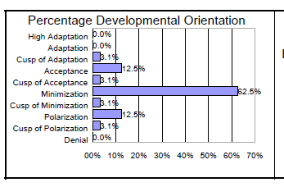
IDI Group Profile Feedback-
Southern Region

Slide 55
IDI Group Profile Feedback- Western Region
Perceived Orientation (PO)
Developmental Orientation (DO)
122.48
123.43
55 70 85 100 115 130 145
96.47
55 70 85 100 115 130 145

Slide 56
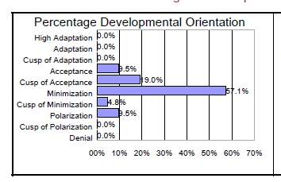
IDI Group Profile Feedback- Western Region

Slide 57
Summary of Overall Group Results
All regions overestimated their level of intercultural competence
Minimization is the level at which all regions scored and it is the level at which most individuals scored
No individual scored at the level of Adaptation and no individual was totally in Denial

Slide 58
Intercultural Development Continuum
Bridges across Difference
Denial
Polarization
Minimization
Acceptance
Adaptation
Deeply Comprehends
Difference
Intercultural
Mindset
De-emphasizes
Difference
Valued & Involved
Understood
Judges
Difference
Not heard
Bridging
Misses
Difference
Universalism
Uncomfortable
Ignored
Assimilation
Monocultural
Mindset
Organizational
Approach
Impact

Slide 59
Remember
The farther we move as individuals and as an organization to the right, the more effective we will be in engaging with, and developing and delivering programs to diverse populations.
Notes:
Remember…

Slide 60
What’s next for you?
Questions???
Individual debrief on your IDI results
  Individual Debriefing will be split 50/50 between:
  A – L (Pamala Morris)
  M – Z (Patreese Ingram)
IDI Individual Development Plan based on your IDI results
Contact me:
pmorris@purdue.edu/ 765-494-8293 and/or
pdi1@psu.edu/ 814-863-7439

