Slide 1
Fusing Social Media and Remote Sensing: A Big Data Challenge

Slide 2
Information Age
“From the dawn of civilization to 2003 we collected 5 hexabyte of data (Eric Schmidt)”
We now collect as much information in two days
Enormous progress in CyberInfrastructure and data mining algorithms

Slide 3
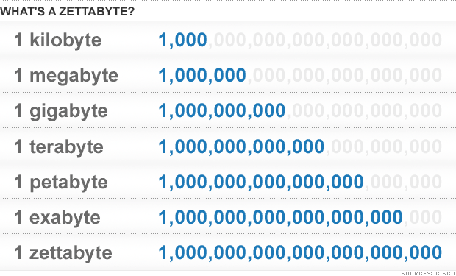
Data Explosion

Slide 4
Data Explosion
If we were talking meters….

Slide 5
Data Rate Vs Population Growth
We collect data at a faster rate than we can analyze them

Slide 6
Data Types
Largest Datasets
Commercial Transactions
Videos and Audio
Remote Sensing
Social Media
Volunteered Geographical Information

Slide 7
From Data to Knowledge
Raw data is useless
Data: recorded information; collection of symbols
Information: Interpreted data
Knowledge: Patterns in data to solve a problem
Solution
Geoinformatics algorithms

Slide 8
CyberScience
Last 3 centuries: observation, theory development, experimentation
Last 3 decades: computation and data-enabled research
10 years ago: CyberScience and Geoinformatics
Far reaching repercussions in the sciences, engineering, and the humanities
Transformative and will continue to change the way research is undertaken

Slide 9
Funding
2002 2004 2006 2008 2010 2012 2014 2016

Slide 10
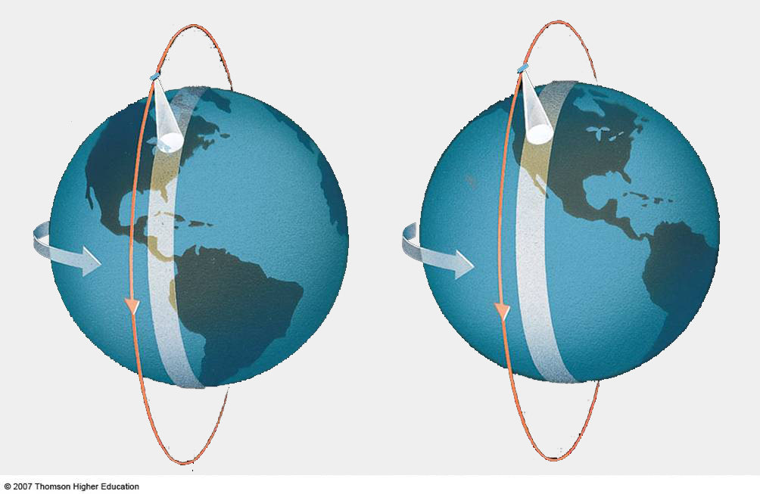
Data Fusion for Hazard Assessment
Augment satellite observation
Revisit time
Atmospheric opacity
Very computation intensive

Slide 11
Need for Cloud Computing
Elasticity: Resources can be allocated depending on requirements
Flexibility: Can address different hazards
Resiliency: Computation can be distributed on different geographical locations unaffected by hazards
Transparency: End user is unaware of which resources are allocated
High Performance: Many more cores than available on a single desktop

Slide 12
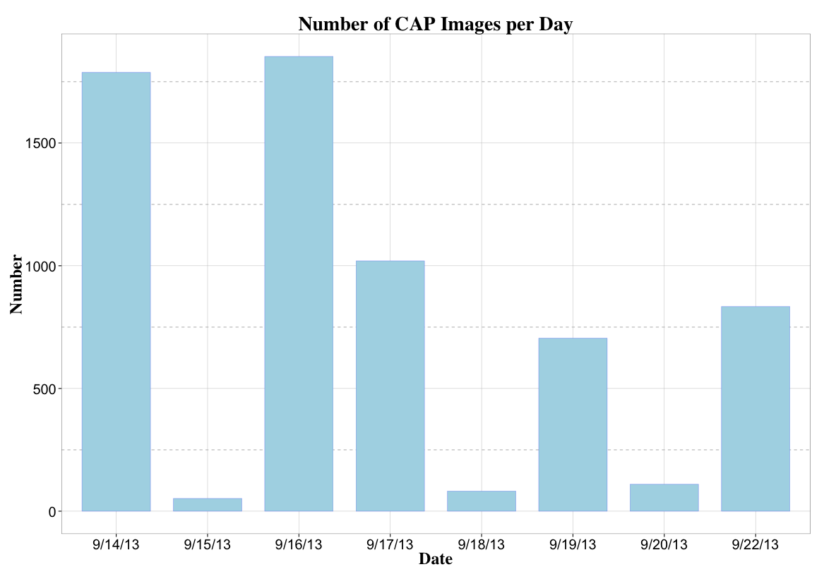
Flood Estimation
Task satellite data
Fuse heterogeneous data sources
Damage to transportation infrastructure
1853
1788
1853
1788
1020
1020
834
705
834
705
52
82
110
52
82
110
Notes:
TALK ABOUT THE FLOOD

Slide 13
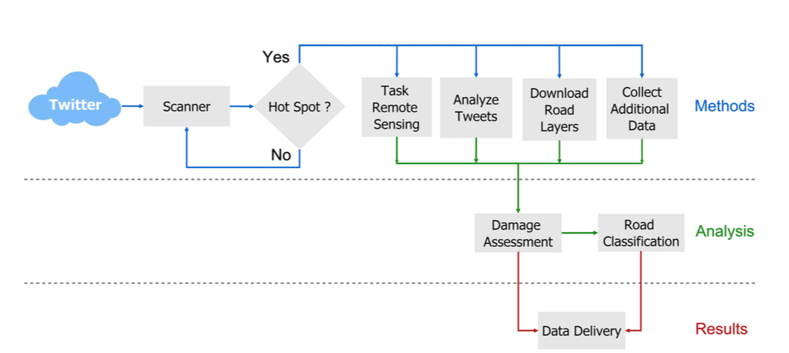
Methodology

Slide 14
Data Fusion

Slide 15
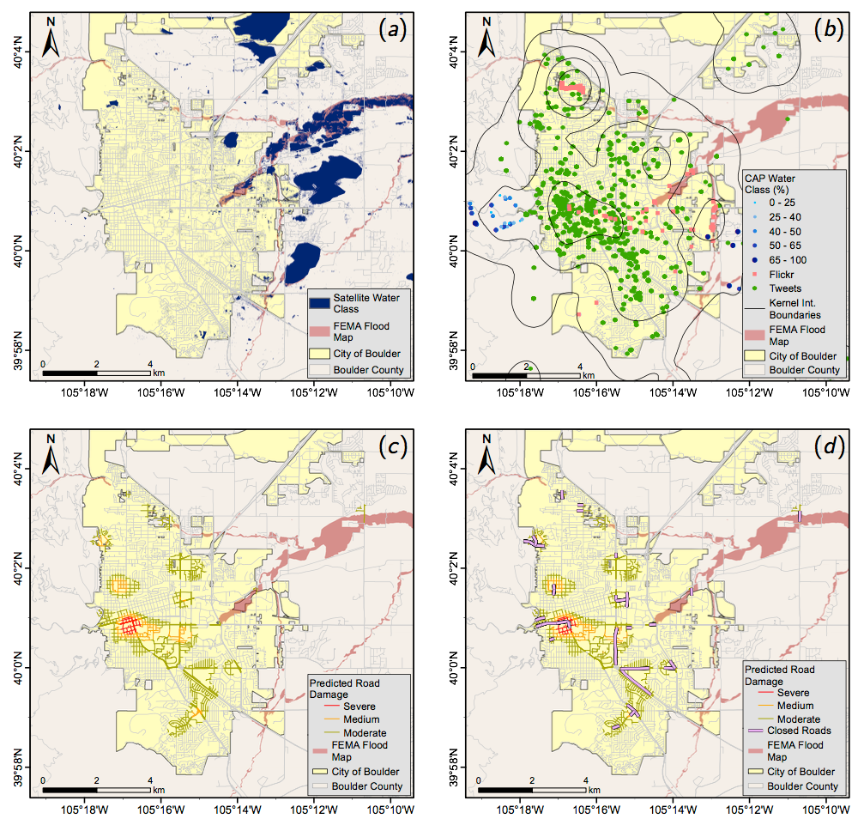
Boulder Damage Assessment

Slide 16
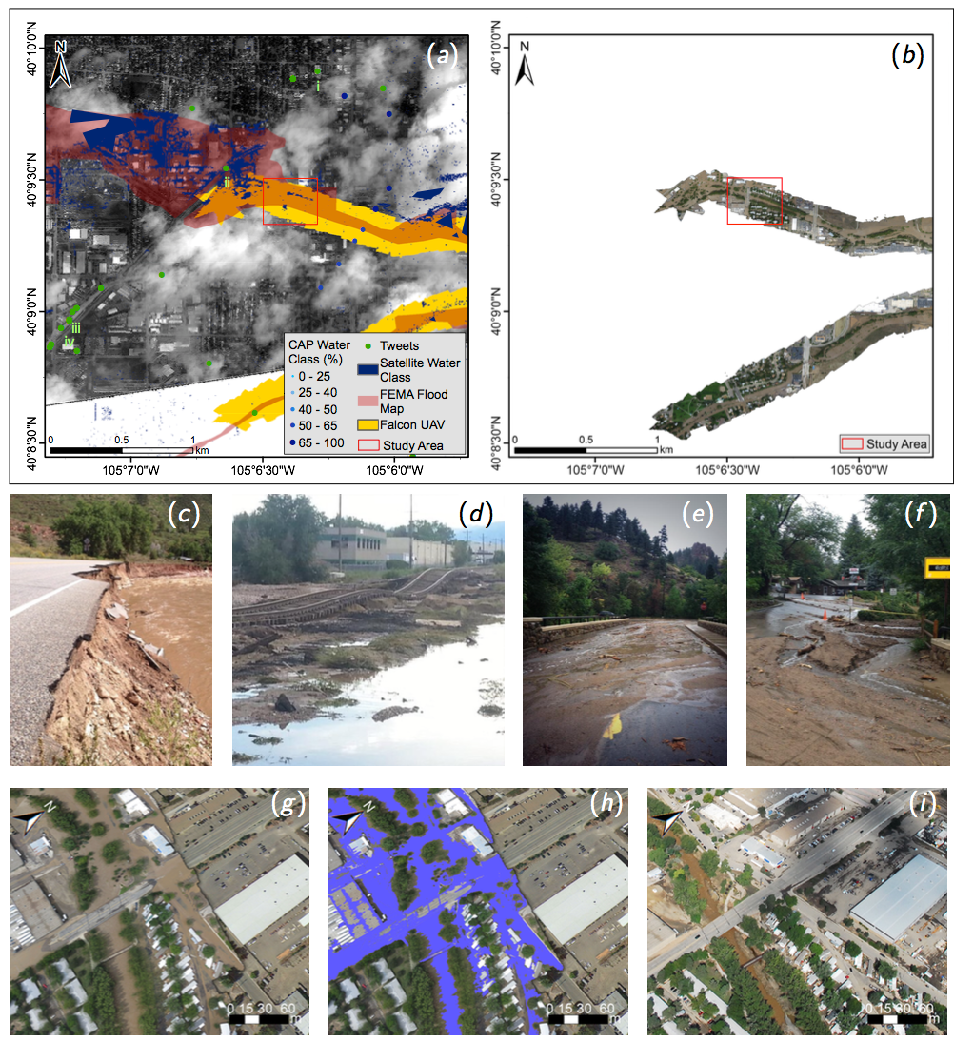
Longmont Damage Assessment

Slide 17
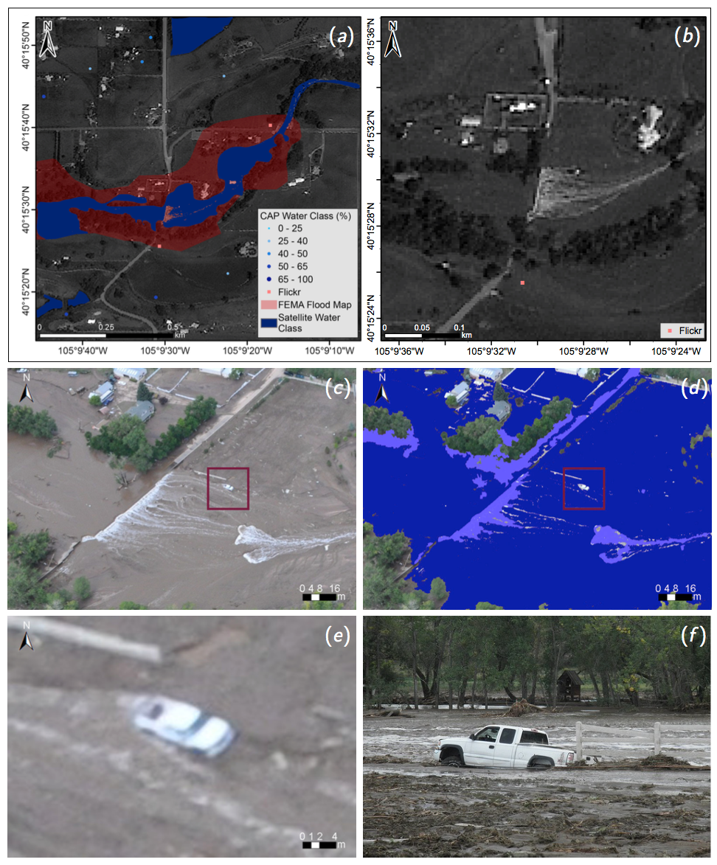
Longmont Damage Assessment

Slide 18
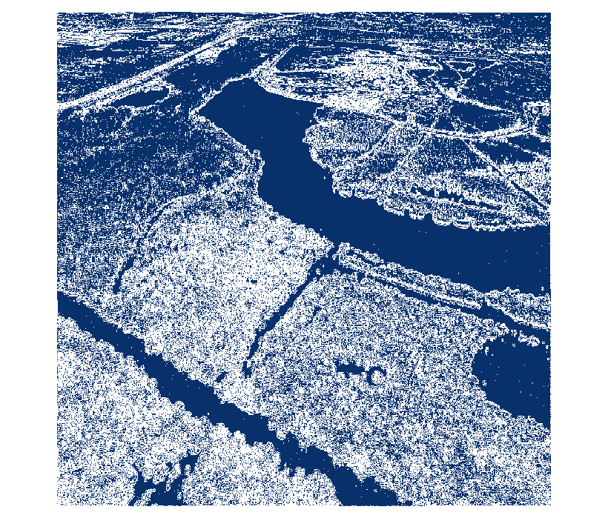
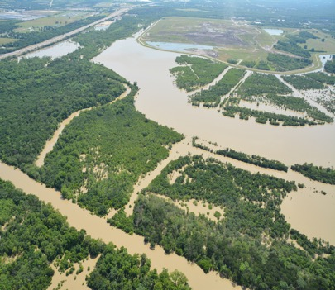
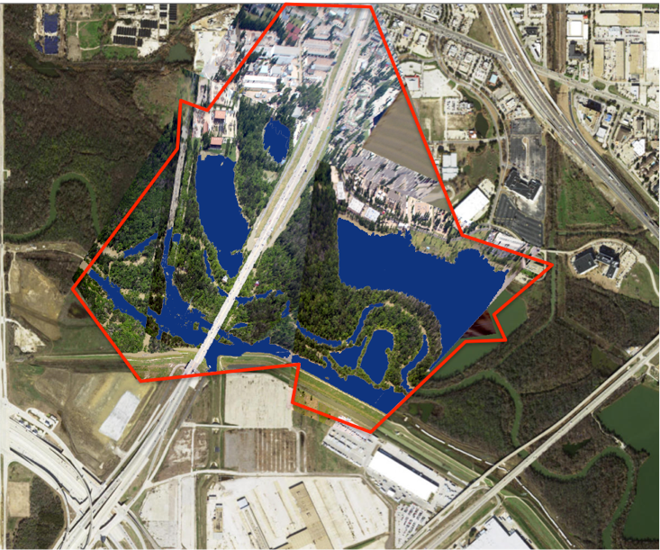
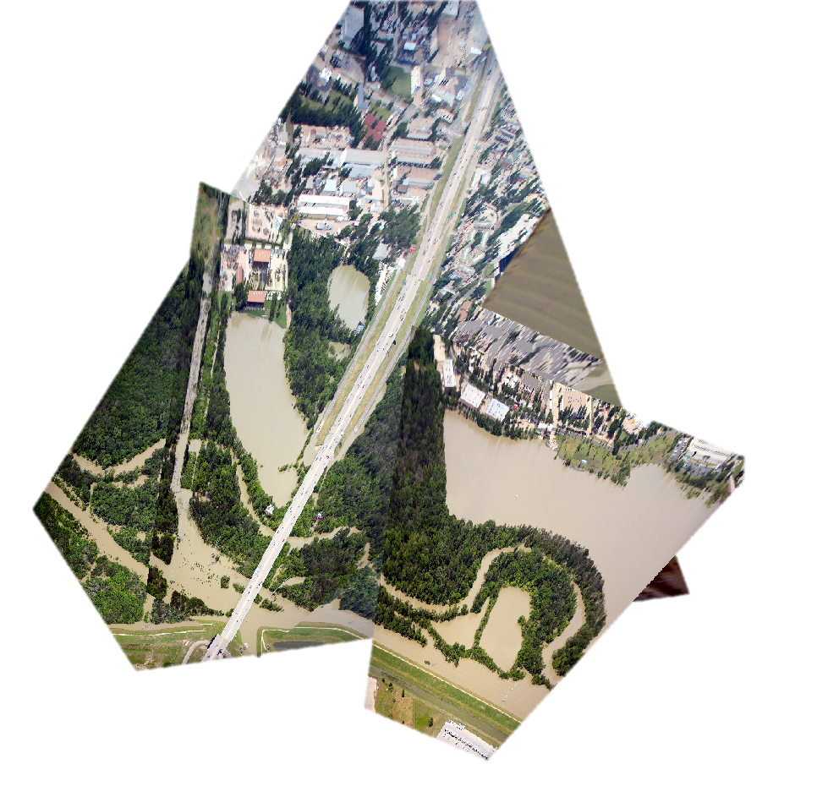
Aerial Image Georectification

Slide 19
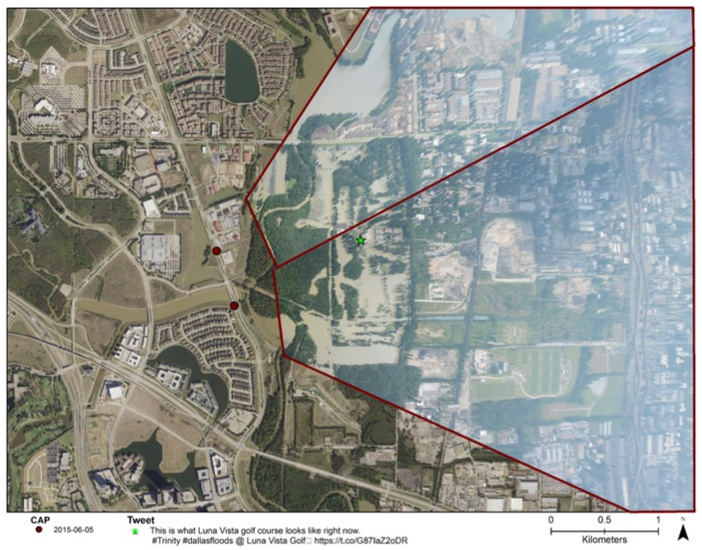
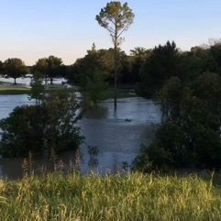
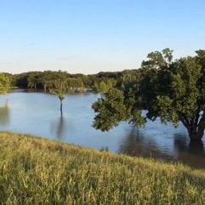
TX Luna Vista Golf Course
“This is what Luna Vista golf course looks like right now. #Trinity #dallasfloods @ Luna https://t.co/G87IaZ2oDR”
https://www.instagram.com/p/3XtoqIPL5n/

Slide 20
Video from Instagram

Slide 21
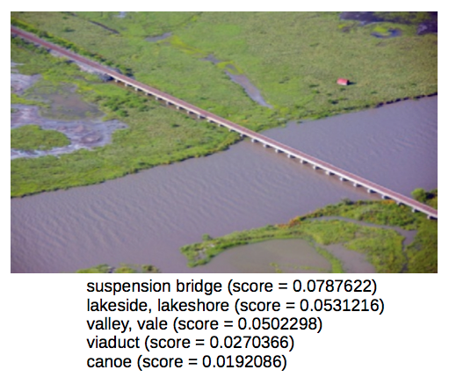
Deep Learning Classification
Notes:
Automatically classify high resolution RS images to aid damage assessment during natural disaster emergencies using TensorFlow

Slide 22
Conclusions
Fusion of heterogeneous data during emergencies
Use of novel data streams
Situation awareness
This research has been funded by:

