Slide 1

A Question of Balance

Slide 2


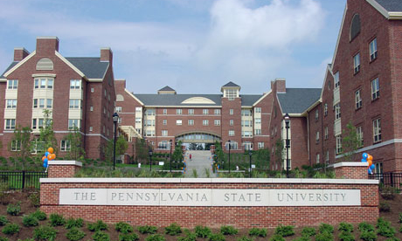
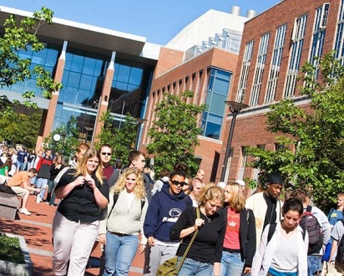
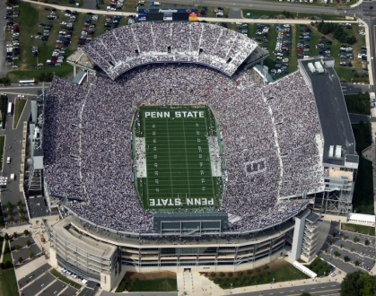
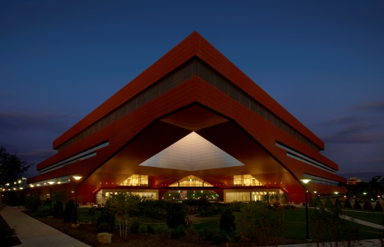
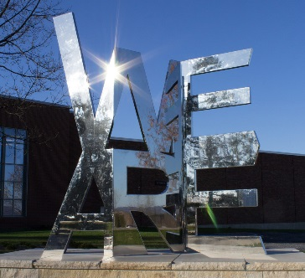
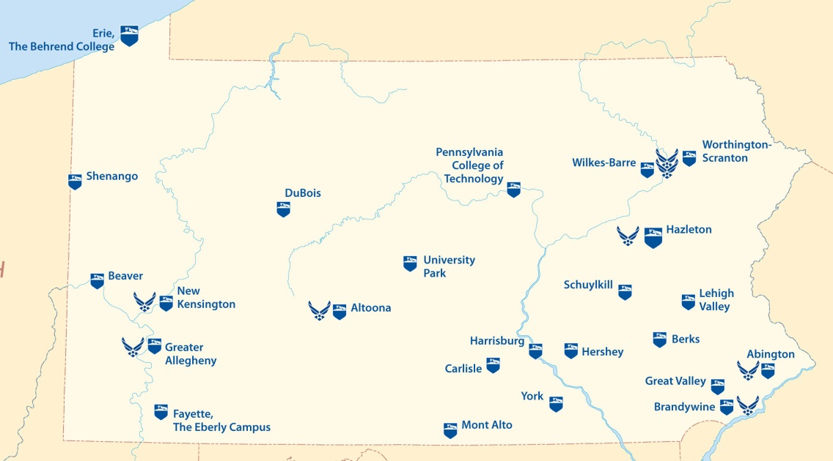

WE ARE PENN STATE
24 campuses
100,000 students
85,000 undergraduates
15,000 graduate students
17,000 faculty and staff
34,000 employees
Research intensive: $863M

Slide 3
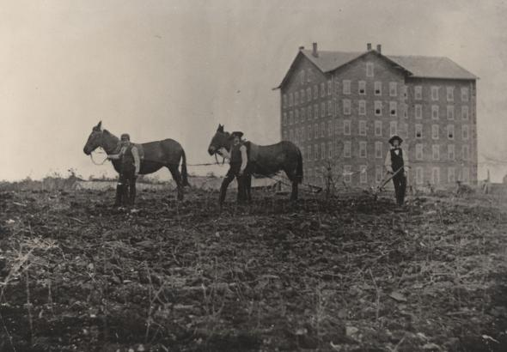
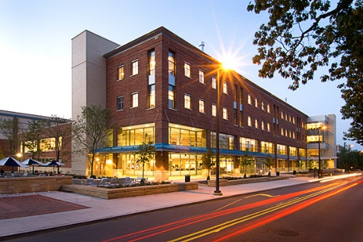

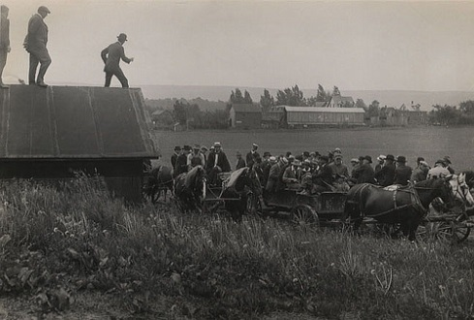

WE ARE:
contributing to a safe, affordable, nutritious food supply
mitigating social and humanitarian challenges
creating jobs, new business opportunities, startups, and careers
providing direct benefits to growers, producers, and allied industries
enhancing human health and wellbeing
helping to preserve and sustain our abundant natural resources
enhancing environmental quality of our water, land, and air
PENN STATE
Notes:
College of Agricultural Sciences – A Strong Tradition
First college established at Penn State. 1861 - Awarded the nation’s first baccalaureate degrees in agriculture
Our students, alumni, research, and extension programs impact all Pennsylvanians.

Slide 4
A Question of Balance
Bret Hess – WAAESD, ESS Chair
Glenda Humiston – WAAESD
Govind Kannan – ARD
Jackie Burns – SAAESD
Doug Buhler – NCRA
Gary Thompson – NERA
Mike Harrington – WAAESD
Alton Thompson – ARD
Eric Young – SAAESD
Jeff Jacobsen – NCRA
Rick Rhodes – NERA
David Leibovitz – NERA
Mary Seaton, Assistant Director, College Relations Office

Slide 5
A Question of Balance
Alternative Sources of Funding: Balancing the Tab for Science Research
BIG DATA: Balancing Impacts, Investments, and Education
The Balance Between a Compliance Mentality and an Inclusive Mindset
The Balance of University Teaching and Research

Slide 6

Kimmel Center for the Performing Arts

Slide 7

A Tour of Civil Rights Reviews and
Discovery of State Best Practices
Latoya Hicks
Equal Opportunity Specialist
National Institute of Food and Agriculture

